Slide 1

NBA Team Trends in 2022

Slide 2
Basketball on Paper
Basketball is hard to quantify
Scoring more points than you allow is good (Point differential, Net Rating, eFG%)
Having fewer turnovers than your opponents is good (TOV%)
Getting more offensive rebounds than your opponents is good (ORR%)
Getting more free throws than your opponents is good (FTR)

Slide 3
Sourcing the data
Sportradar NBA API: https://developer.sportradar.com/
Sportradar has a number of APIs with extensive coverage of a huge array of sports.

Slide 4
Data cleaning
We took the Standings data to create a loop of all the teams IDs.
Used the loop to go through the statistics data and created a data frame with each teams stats.
Used this data to calculate more statistics relative to conferences.

Slide 5
Comparison of Conferences
Question 1
Is the style of play different across the Eastern and Western Conference?(in relation to the four factors, offensive/defensive rating, pace and space, etc)
Conventional wisdom is that the west is higher paced, more focused on offense, and stronger overall. Is this borne out in the data?

Slide 6
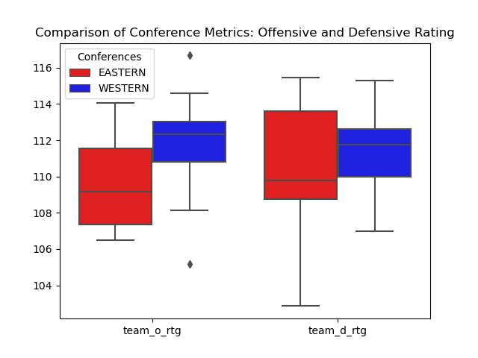

Slide 7
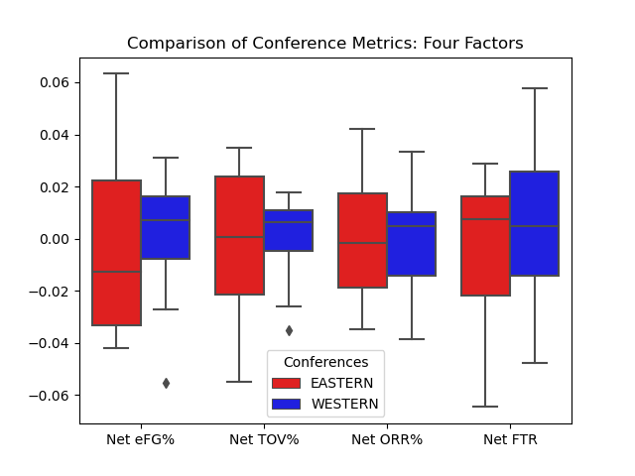

Slide 8
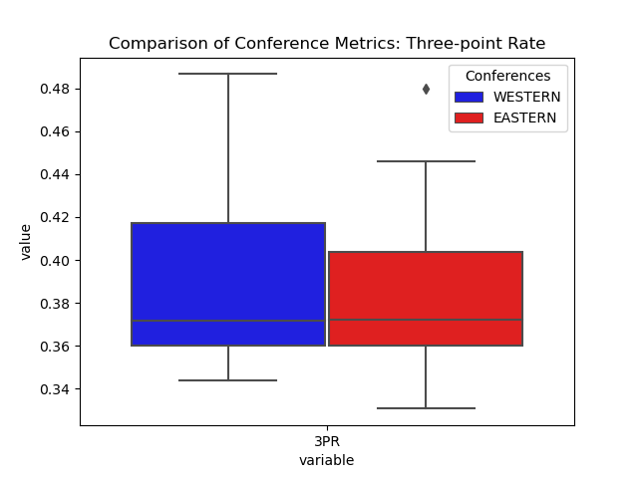

Slide 9
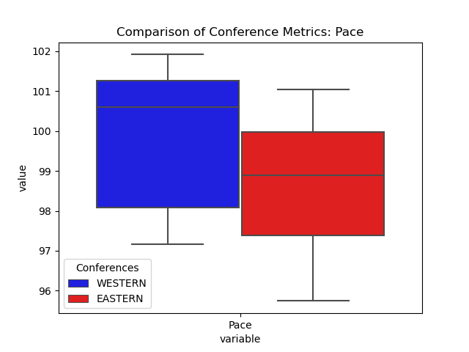

Slide 10
Takeaways
The stereotype of the west being more oriented towards offense might have some truth to it.
The level of competitiveness in the western conference is higher, as the teams are more evenly matched.
Ultimately, the differences in pace and style of play between the two conferences may come down to personal preference and individual team strategies, rather than any inherent superiority of one conference over the other.

Slide 11
What is conducive to winning?
Question 2
Defensive Rating (points allowed per 100 possessions
Offensive Rating (points scored per 100 possessions)
Four factors weighted sum
Point differential
Net Rating (O Rtg - D Rtg)

Slide 12
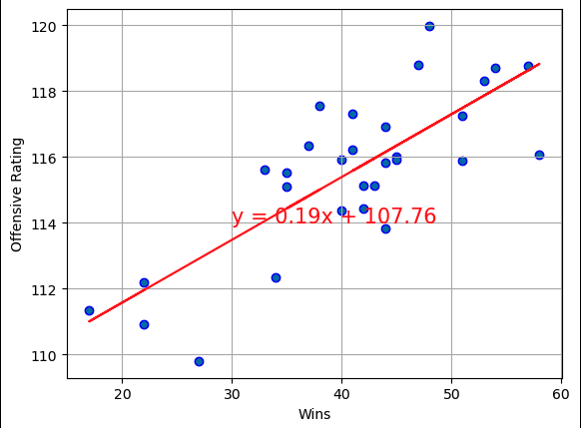
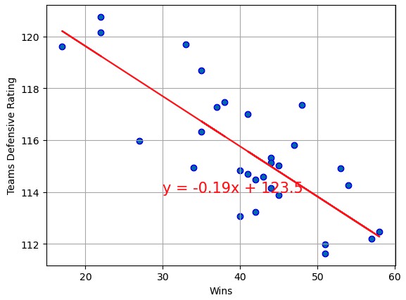
“This is a super-important quote”
Teams Offensive and Defensive Ratings
- From an expert

Slide 13
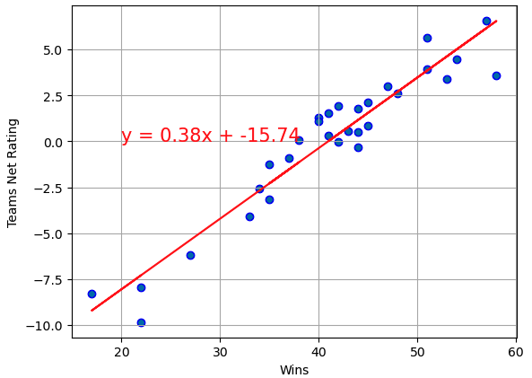
Teams Net Rating

Slide 14

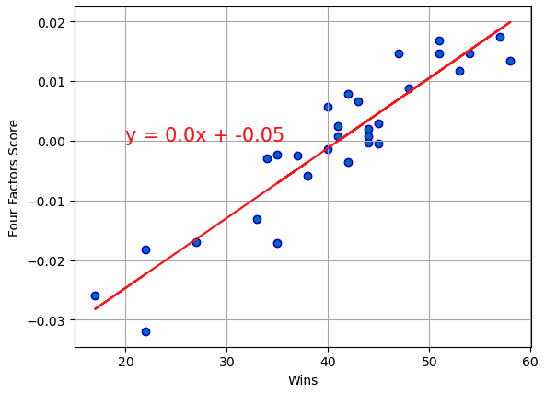
Four Factors Weighted Sum

Slide 15
Takeaways
Offense and defense both matter.
Net rating is at least as good a predictor of wins as the four factors

Slide 16
Which conference is stronger?
Net Rating
Four Factors

Slide 17
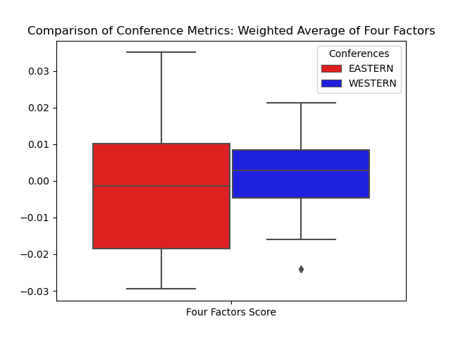

Slide 18
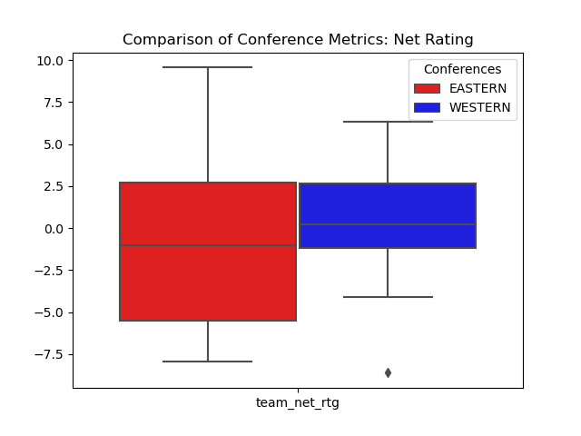

Slide 19
Conventional basketball wisdom says that it doesn’t agree with the conclusions of “analytics”, but the data says otherwise

